Slide 1
Online Questions Sequesing Personalization in E-learning
Based on:
EduRank: A Collaborative Filtering Approach to Personalization in E-learning
Avi Segal, Ziv Katzir, Ya’akov (Kobi) Gal, Guy Shani and Bracha Shapira
Proceedings of the 7th International Conference on Educational Data Mining
(EDM 2014)

Slide 2





E-learning
User
Questions
E-learning system

Slide 3

Pre-Ordering By difficulty
Pre-order by difficulty ranking.:
Question <–> question
User <-> User
1
2
3

Slide 4




Gold Standard ranking
correct first attempt
number of attempts
Elapsed time
Difficulty ranking

Slide 5
Edurank
Q1
Q2
Q2
U1
1
2
4
U2
2
5
4
U3
2
3
5
U4
?
?
?
CF

Slide 6
Pre-Ordering By difficulty
Q1
Q2
Q2
U1
U1
1
2
4
U2
2
5
4
U2
U3
2
3
5
U4
1
2
3
U3

Slide 7
Evaluation

Slide 8
KDD cup 2010 dataset
Algebra Q&A dataset
EduRank feature space: user, question, difficulty

Slide 9
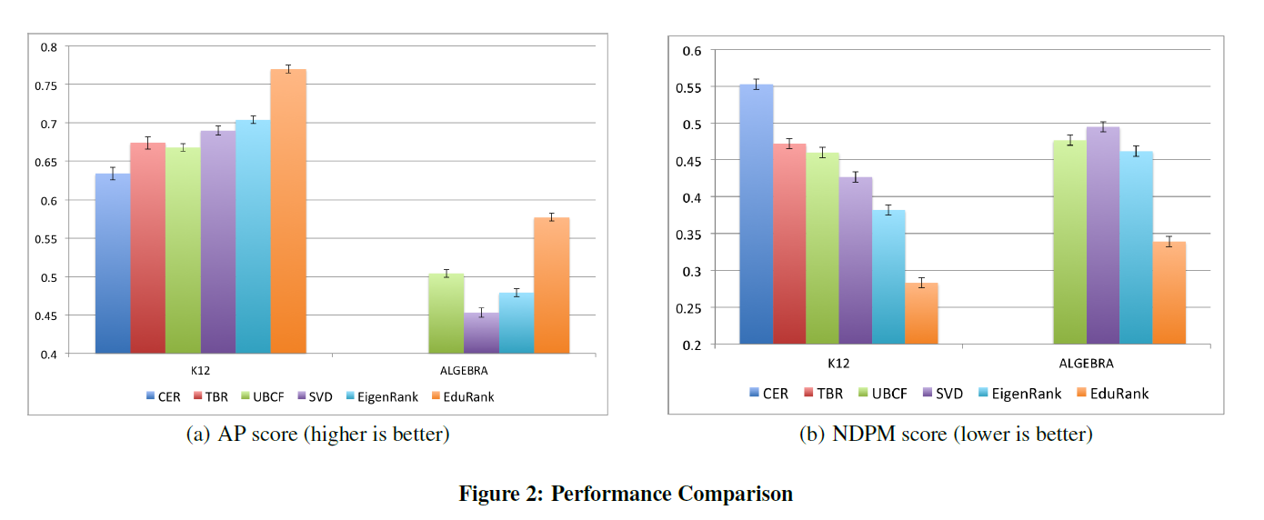
Evaluations

Slide 10
Pre-Ordering By difficulty
Q1
Q2
Q2
U1
U1
1
2
4
U2
2
5
4
U2
U3
2
3
5
U4
1
2
3
U3

Slide 11
Pre-Ordering By difficulty
Q1
Q2
Q2
U1
U1
1
2
4
U2
2
5
4
U2
U3
2
3
5
U4
1
2
3
U3

Slide 12
Pre-Ordering By difficulty
Q1
Q2
Q2
U1
1
2
4
U2
2
5
4
Q1
U4
U3
2
3
5
U4
1
2
3

Slide 13
Pre-Ordering By difficulty
Q1
Q2
Q3
U1
1
2
4
U2
2
5
4
Q1
U4
U3
2
3
5
U4
1
3
2
3
Q1 = 3
retrain

Slide 14
Pre-Ordering By difficulty
Q1
Q2
Q3
U1
1
2
4
U2
2
5
4
Q3
U4
U3
2
3
5
U4
1
3
2
3
4
3

Slide 15
future work
Compare to sequential pattern mining (SPM)
Compare different sequencing strategies
Minimize amount question

Slide 16


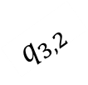



Online ordering
$$d_{q1,1}=1$$
$$q_{1,1}$$
Choose next easiest question
Reinforcement learning
LSTM
$$q_{2,1}$$
$$d_{q2,1}=3$$
$$q_{3,2}$$
2
$$d_{q3,2}=2$$

Slide 17
Pre-Ordering By difficulty ranking
Pre-order by difficulty ranking.:
LSTM – seq to seq
1
2
3

Slide 18
easiest
…
hardest
All users encoder
User-i decoder
RNN
RNN
RNN
easiest
…
hardest

